Slide 1
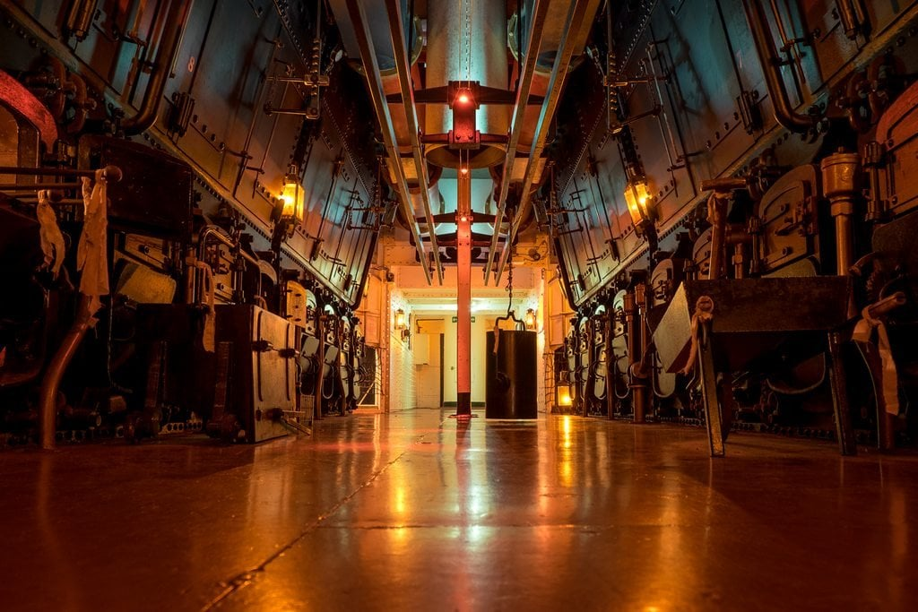
Maritime Boilers Lecture

Slide 2
Overview
History
- Naval History of evolution 1812-1945
Engineering
Evolution
Types parts
Diving Boilers
-Short look at researching wrecks
-Details about specific wrecks

Slide 3
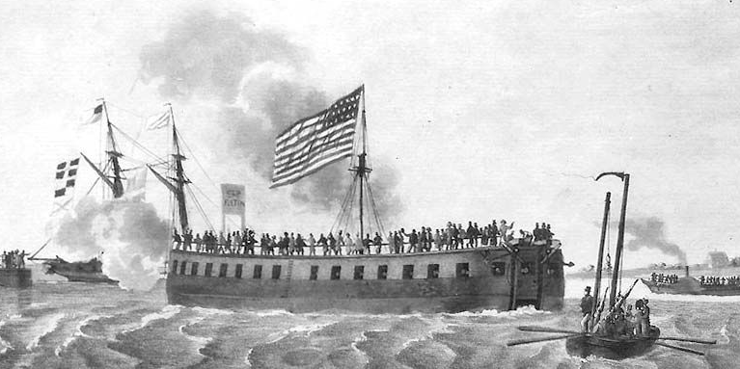
USS Demologos/Fulton (1916))

Slide 4
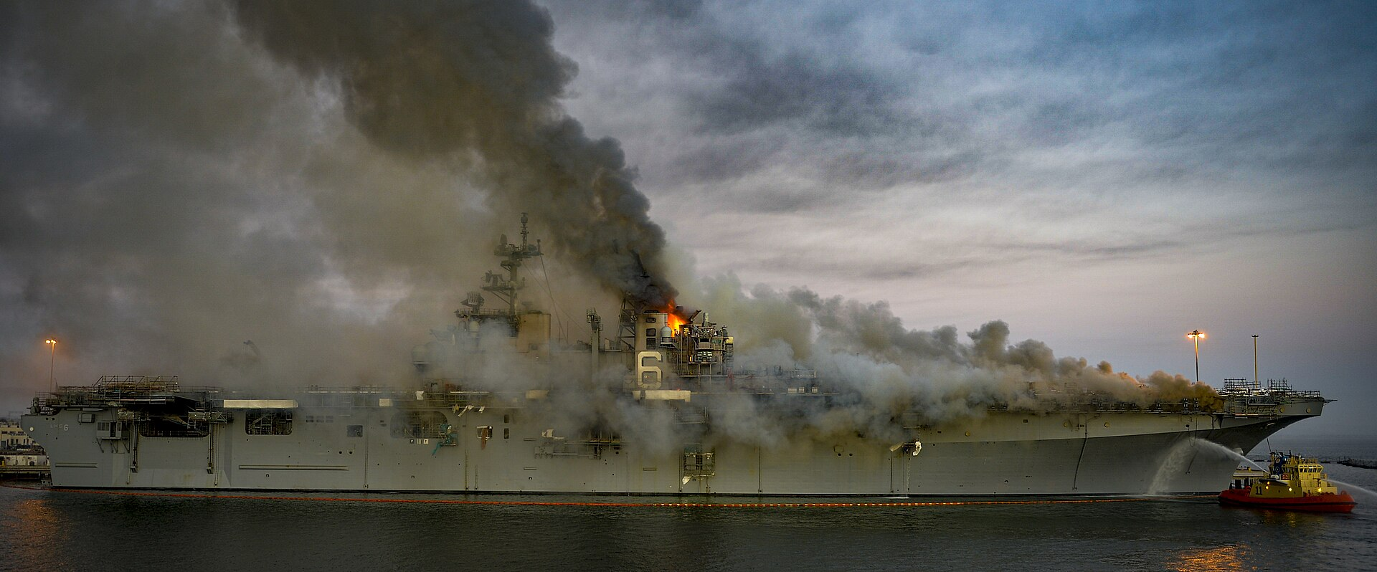
USS Bonhomme Richard LHD-6 (1998)

Slide 5
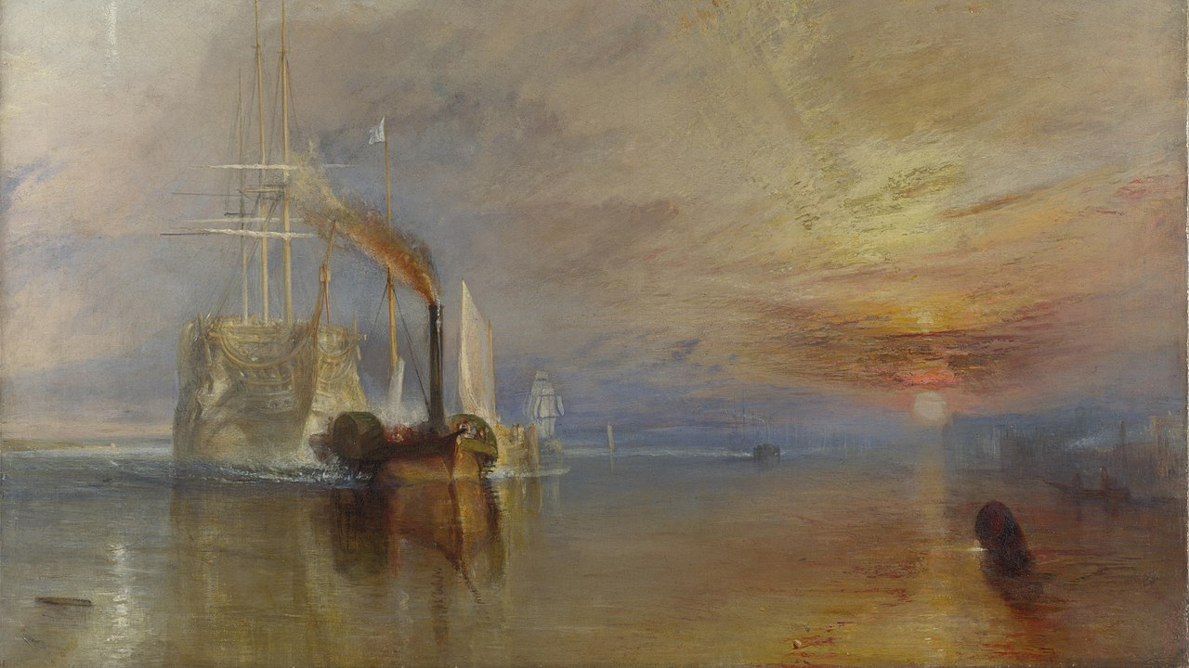
The Fighting Temeraire, tugged to her last berth to be broken up, 1838

Slide 6
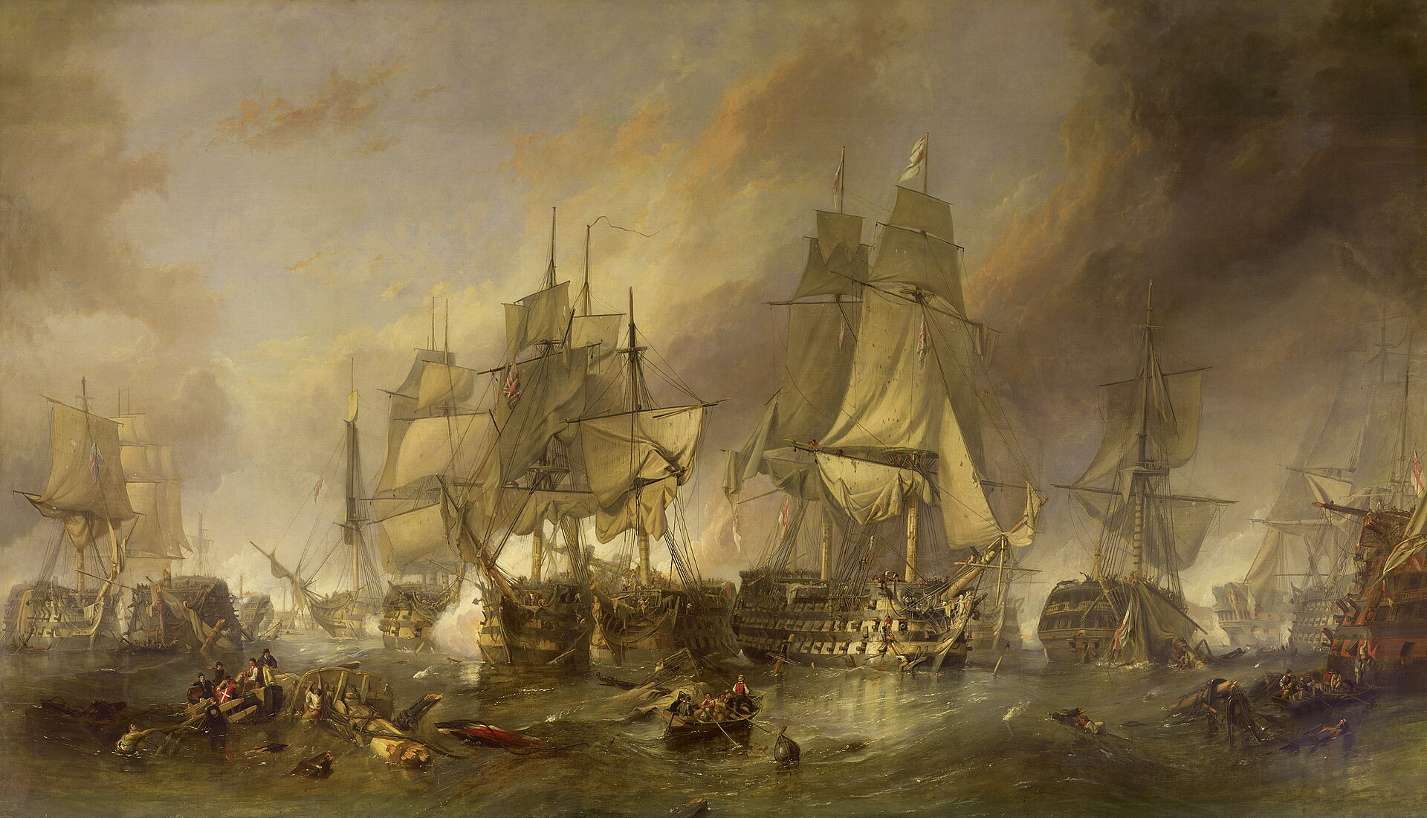
The Battle of Trafalgar (1805)
MN Redoubtable
HMS Victory
HMS Temeraire

Slide 7
The Fighting Temeraire, tugged to her last berth to be broken up, 1838

Slide 8
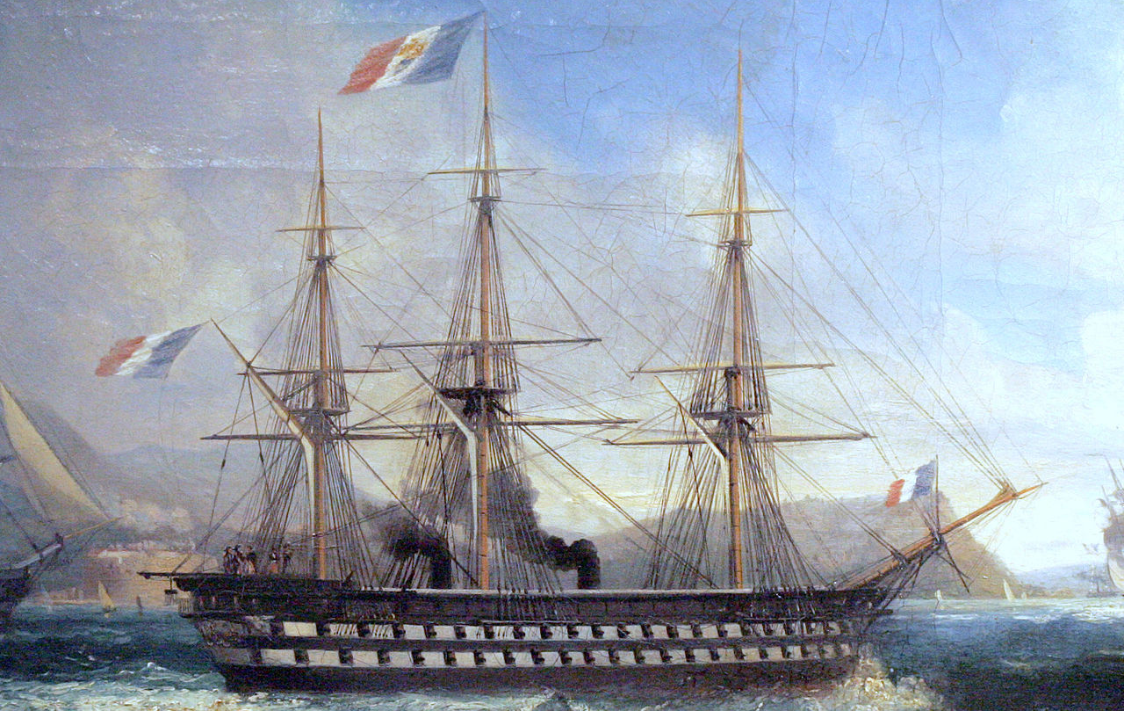
The Napoleon At Toulon 1852

Slide 9
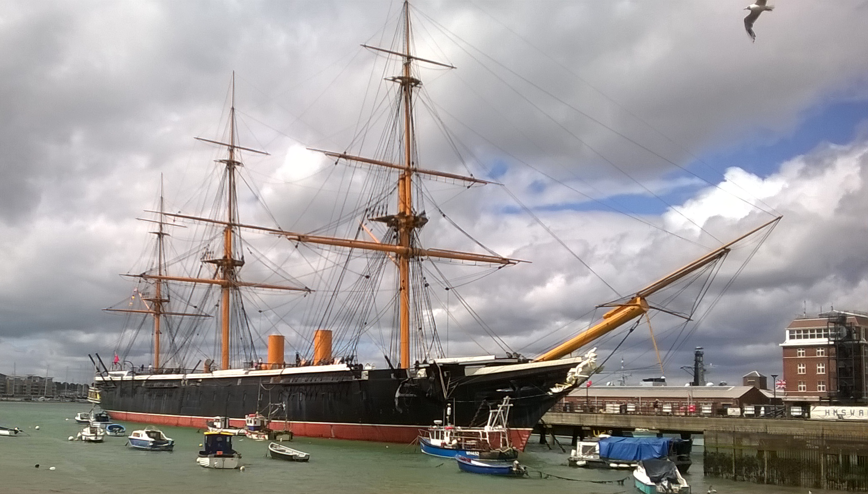
HMS Warrior (1861)

Slide 10
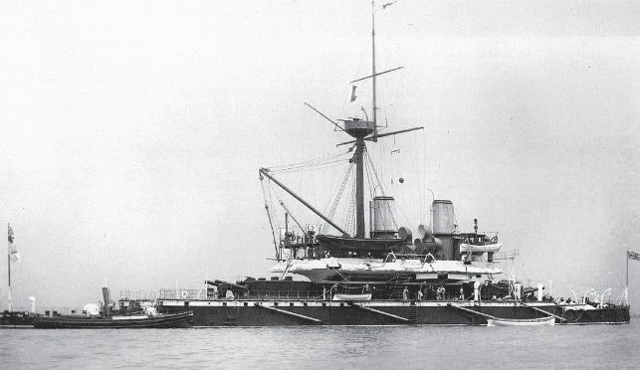
HMS Devastation (1871)

Slide 11
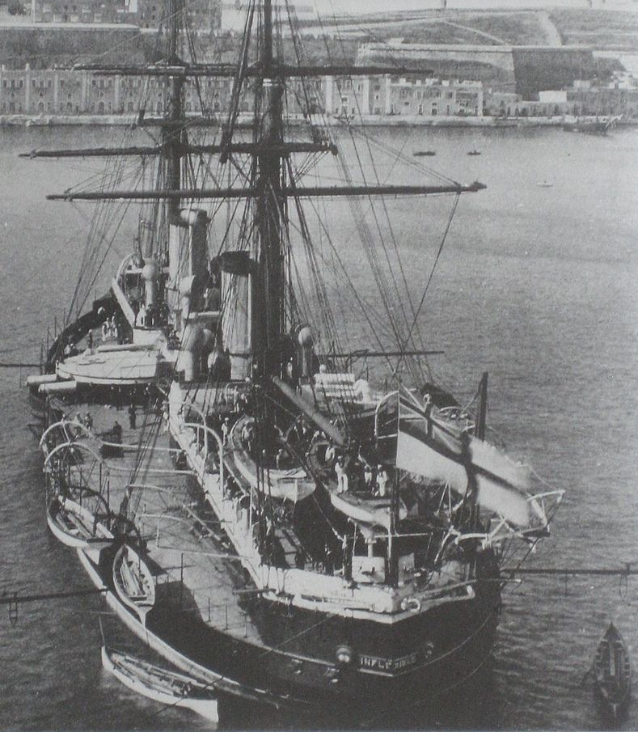
HMS Inflexible (1876)

Slide 12
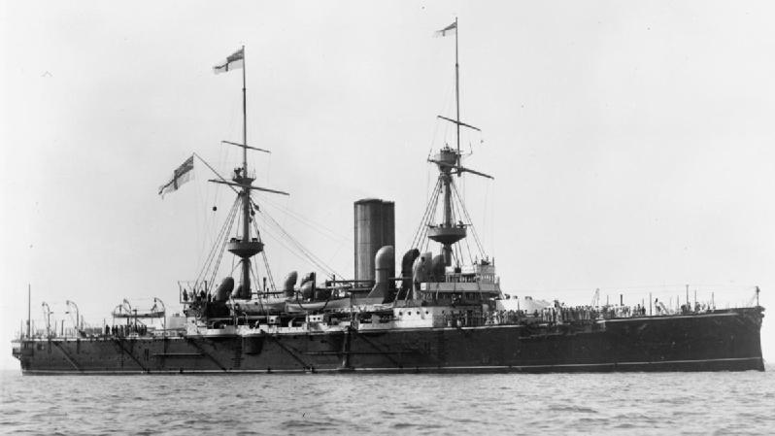
HMS Barfleur (1894)

Slide 13
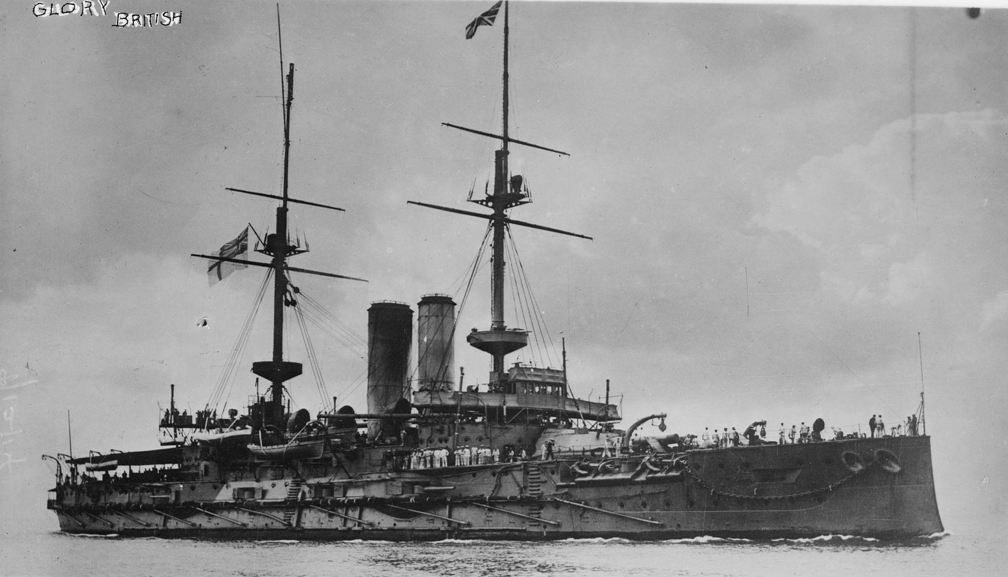
HMS Glory (1900)

Slide 14
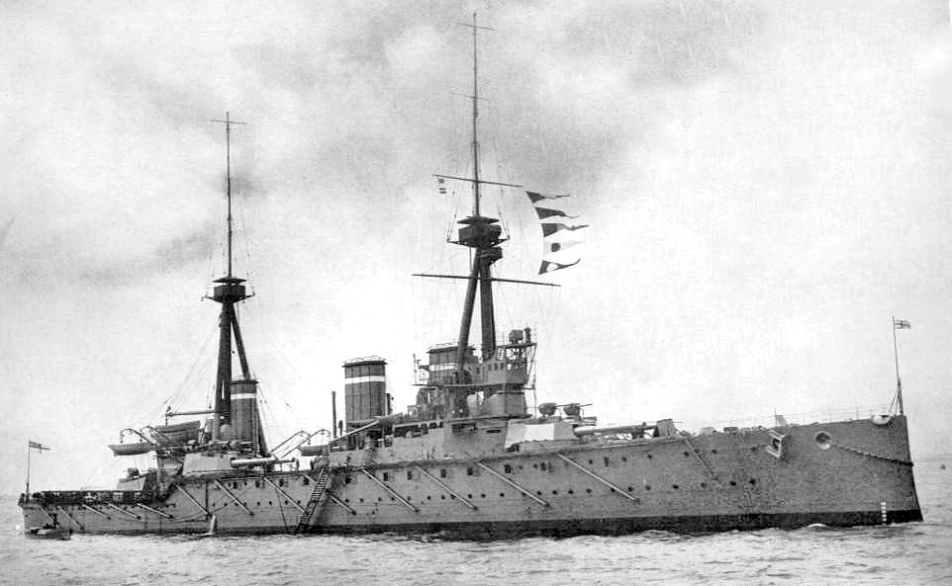
HMS Invincible (1907)

Slide 15
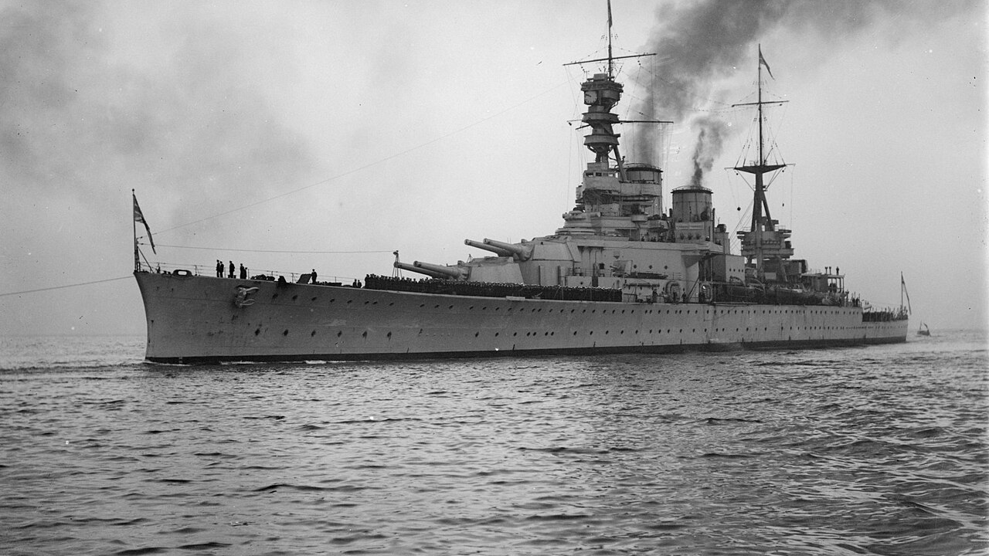
HMS Renown (1916)

Slide 16
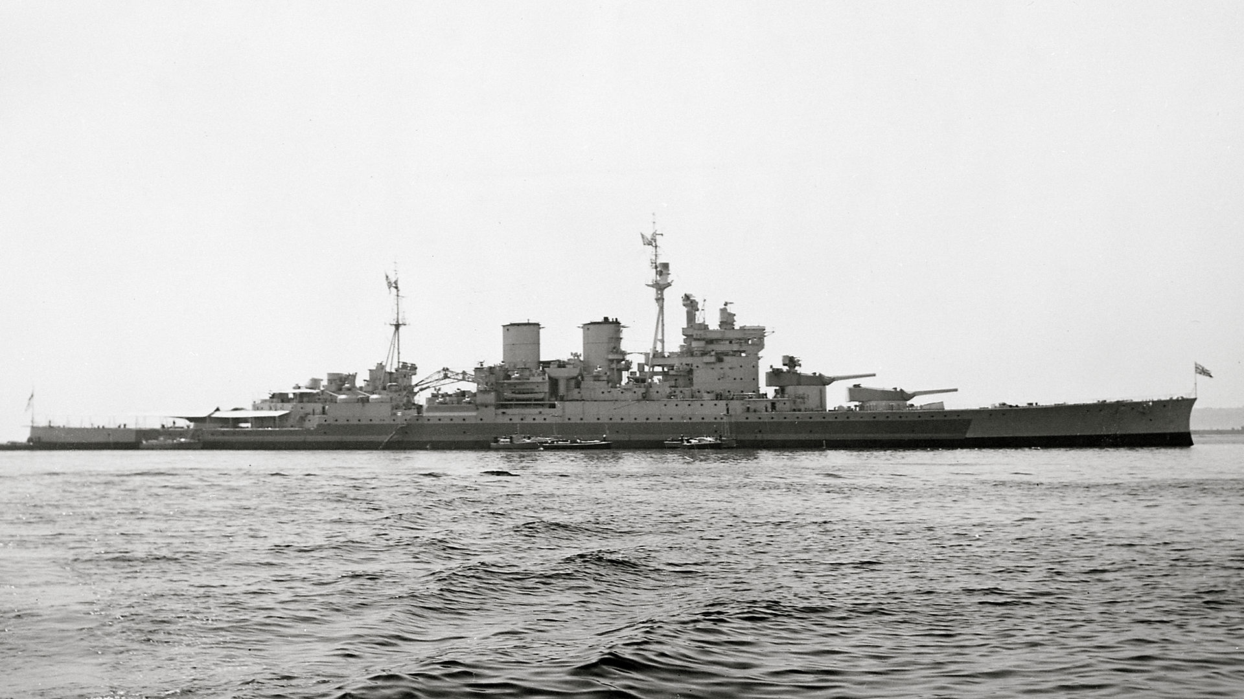
HMS Renown (1939)

Slide 17
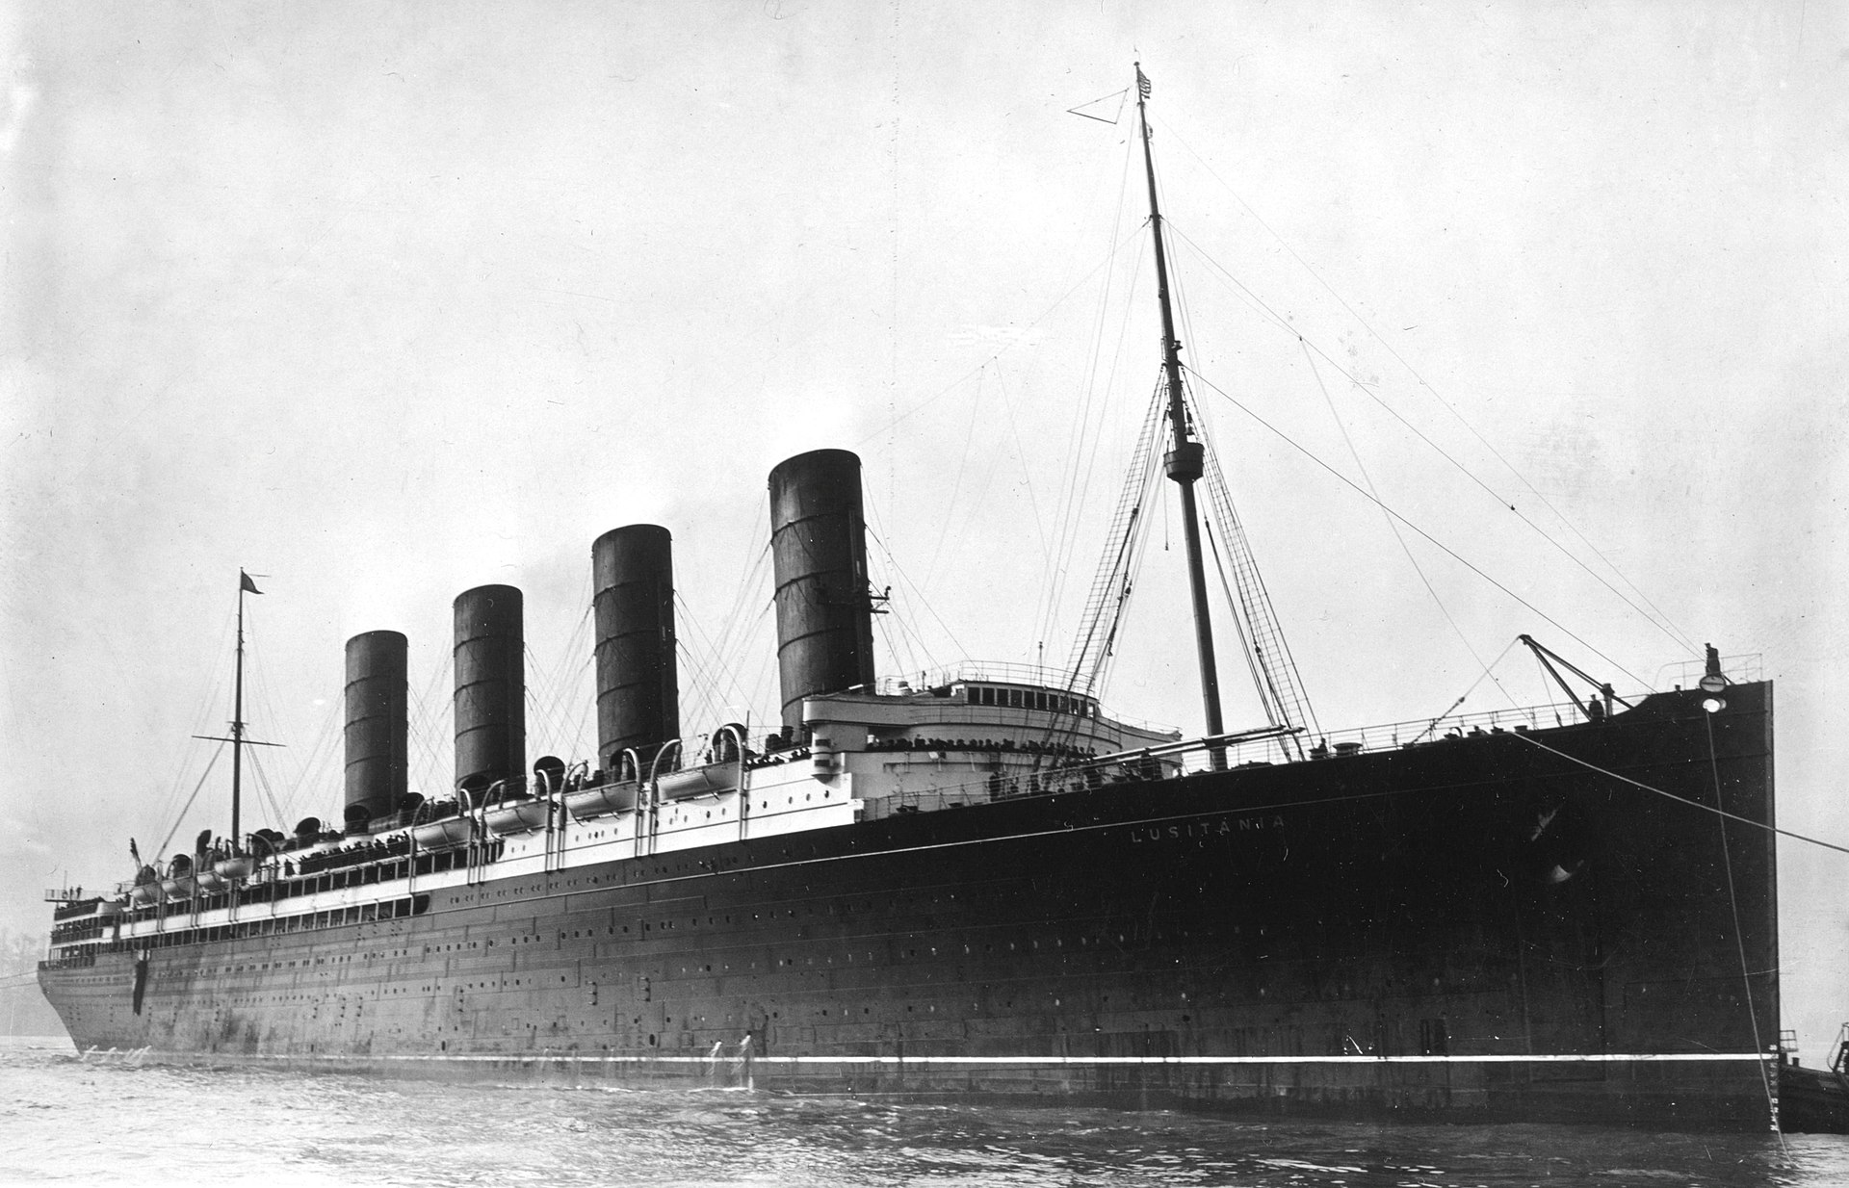
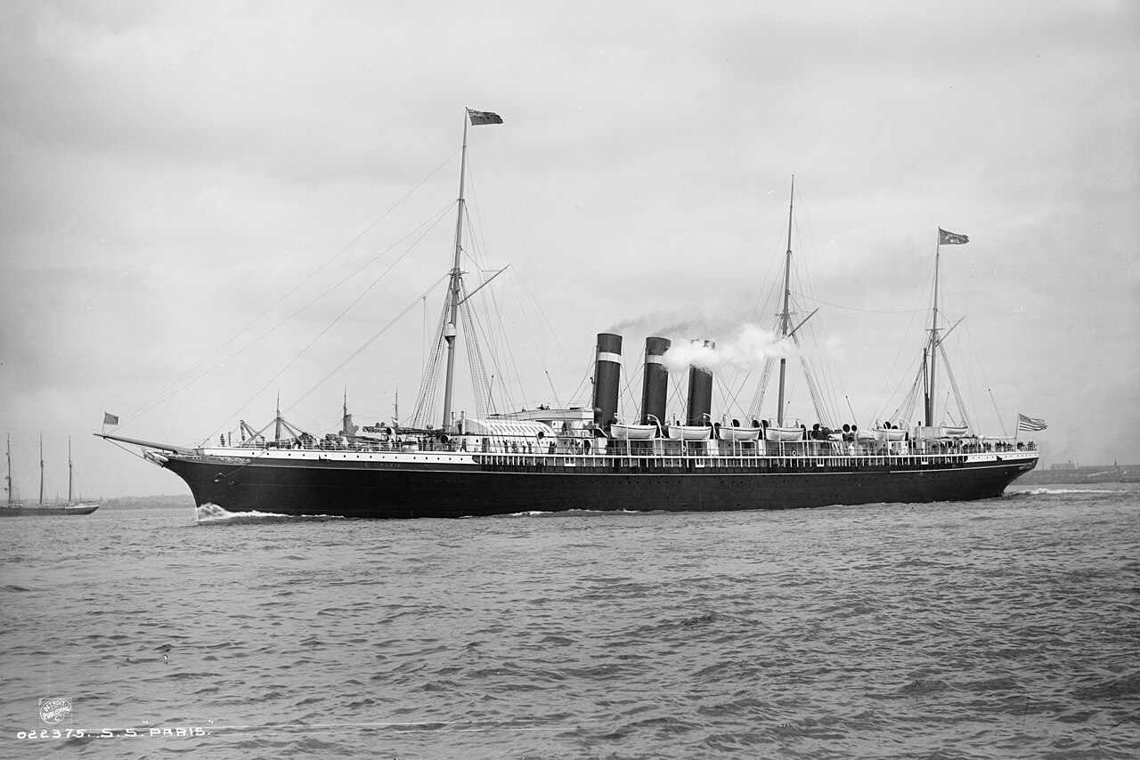
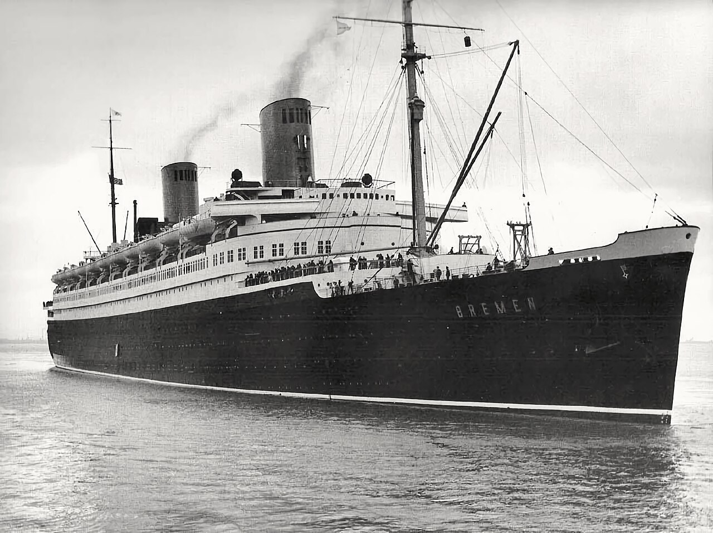
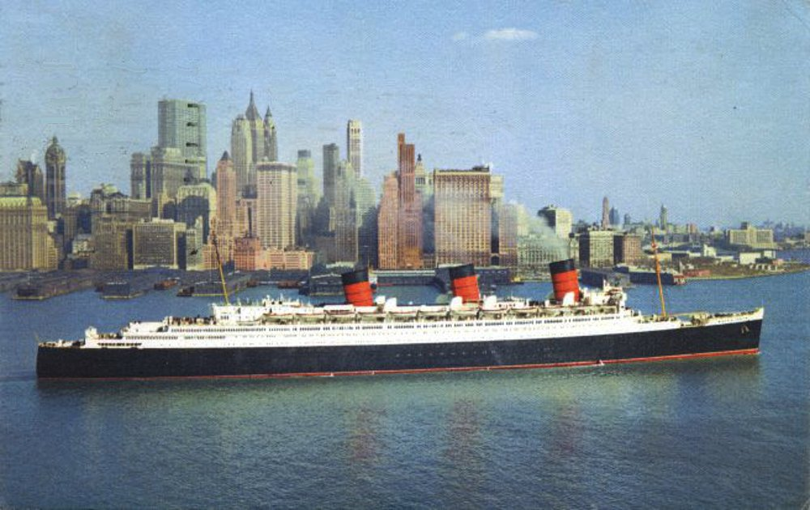
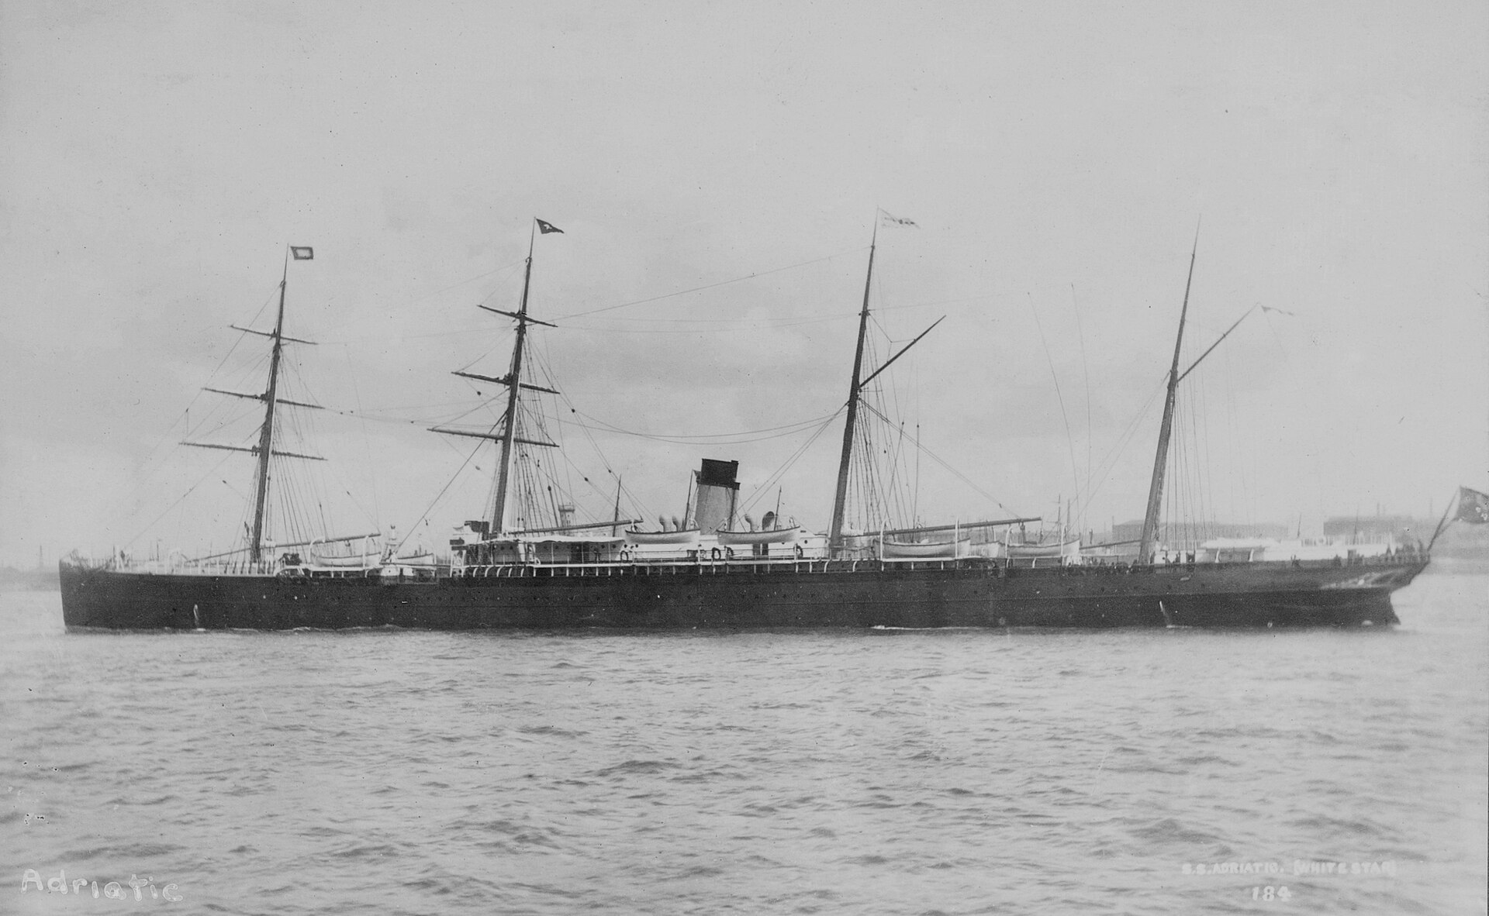
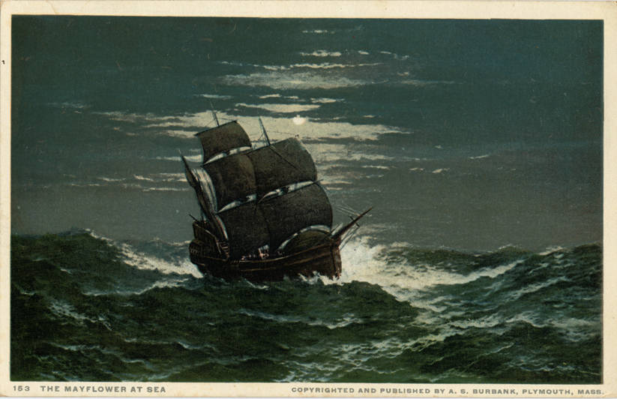
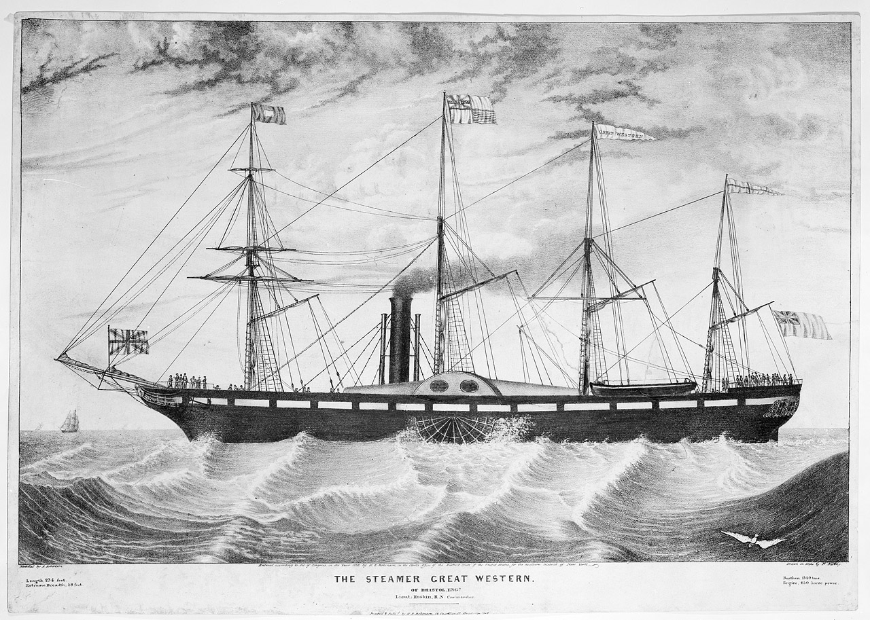
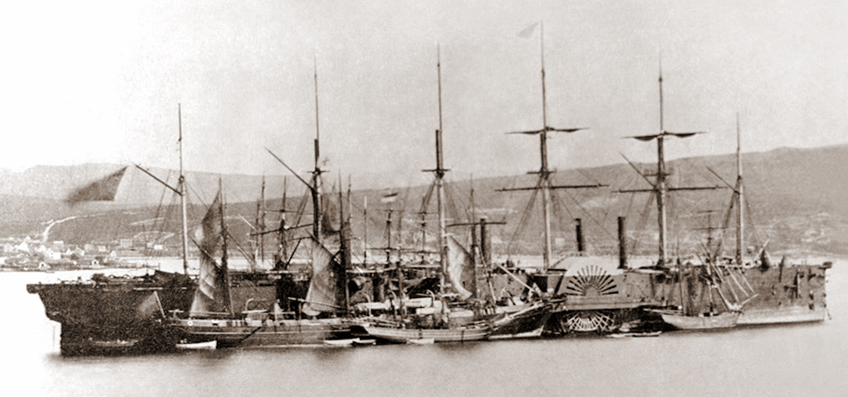
Duration of the Transatlantic crossing
1620 66 days - Mayflower
1838 16 days – PS Great Western
1860 11 days – screw and paddles and massive SS Great Eastern
1872 7 days 23 hours – single screw SS Adriatic
1889 5 days 19 hours – Twin Screw SS City of Paris
1907 4 days 20 hours – Steam turbine RMS Lusitania
1929 4 days 3 hours – Bulbous bow SS Bremen
1936 4 days – Yarrow boiler RMS Queen Mary

Slide 18
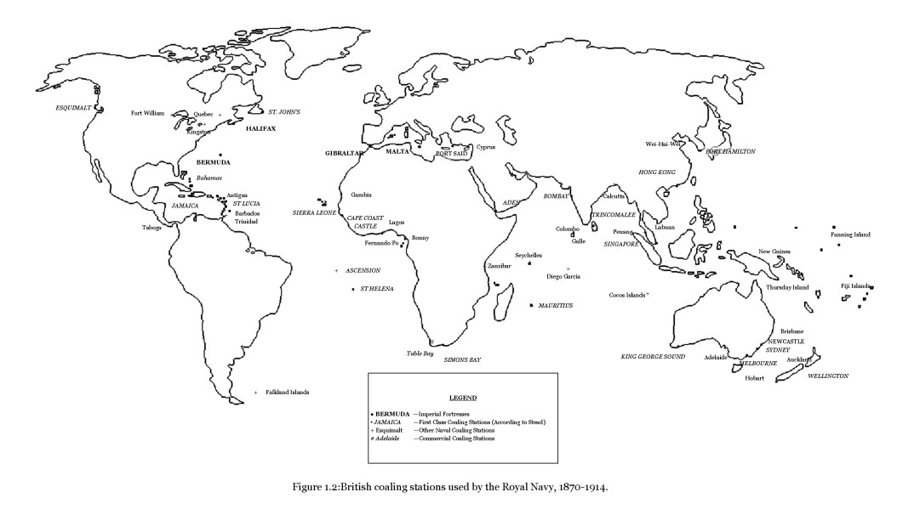

Slide 19
Engineering and boiler types

Slide 20
Boiler topics
Haystack
Expansion engines VS Turbines
Water-tube
Superheater
Turbo-electric drive
Balanced draught
Saturated VS Superheated steam
Small-tubed
Coal-fired
Economiser
High-pressure boiler
Auxiliary Boilers
Flued
Oil-fired
Forced draught
Condenser
Three-drum boiler
Fire-tube
Boiler room placement
Boiler control
Funnels & trunking
Induced draught
Diesel engines
Pre-Heater
Auxiliary uses of steam
Brick laying
Gas turbines
Nuclear PWR (pressurised water reactor)
Soot Blowers
Stoking
Once-Through Boiler
Boiler Maintenance

Slide 21
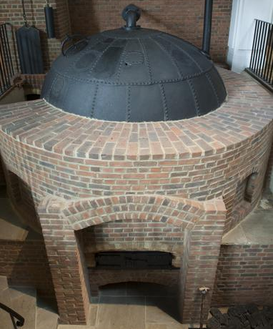
Haystack boiler

Slide 22
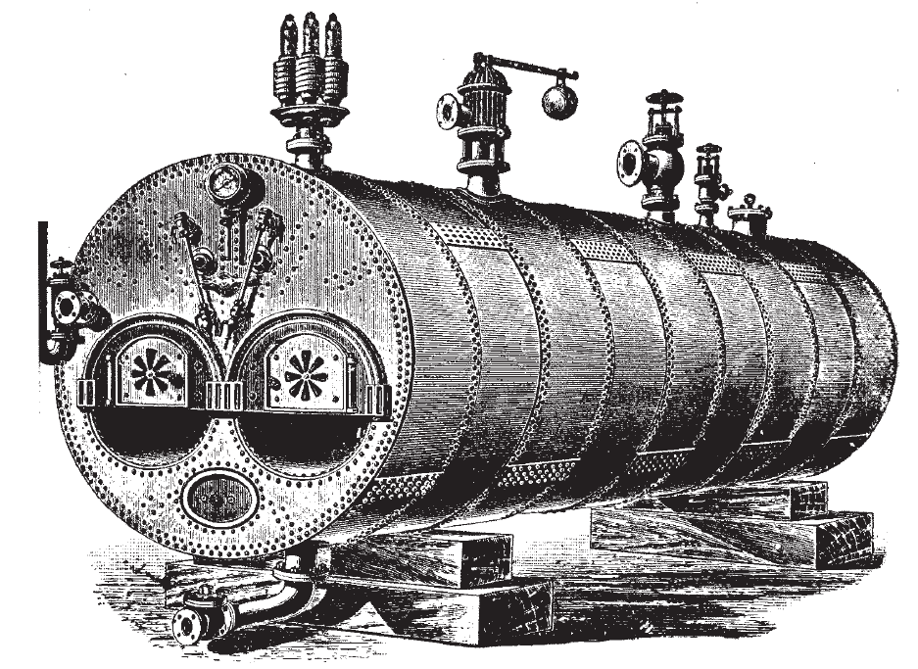
Flued boiler
Lancashire Boiler

Slide 23
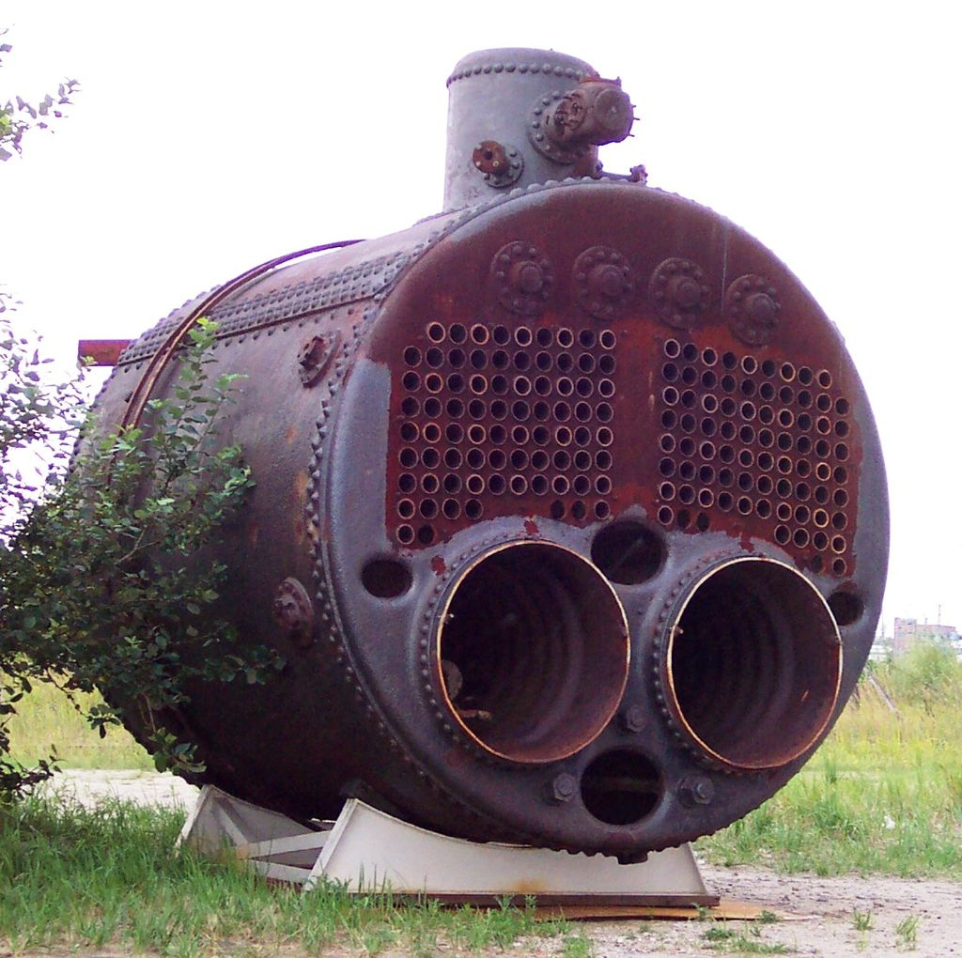
Fire-tubed boiler
Scotch Boiler

Slide 24
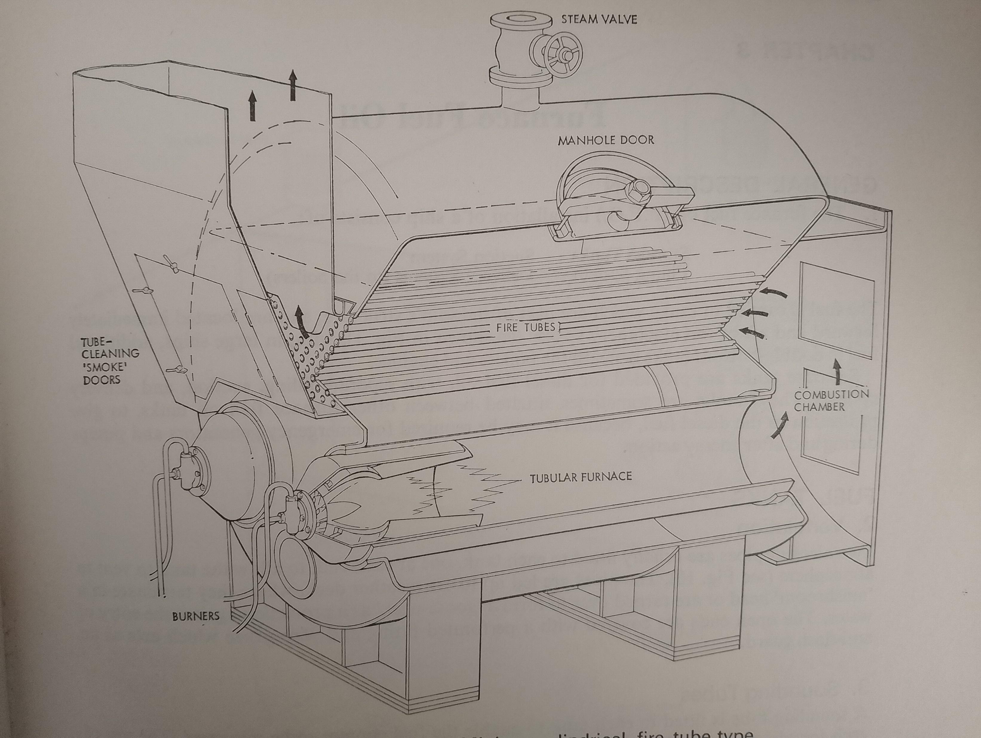
Fire-tubed boiler

Slide 25
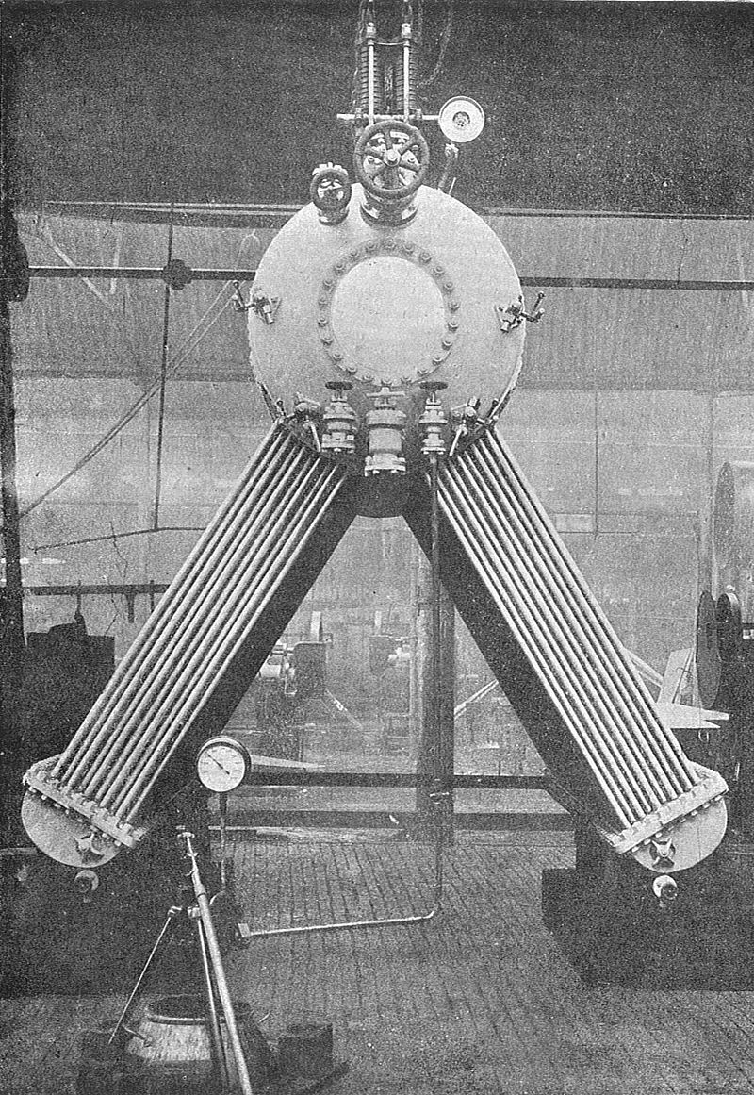
Water-tubed boiler
Yarrow Boiler

Slide 26
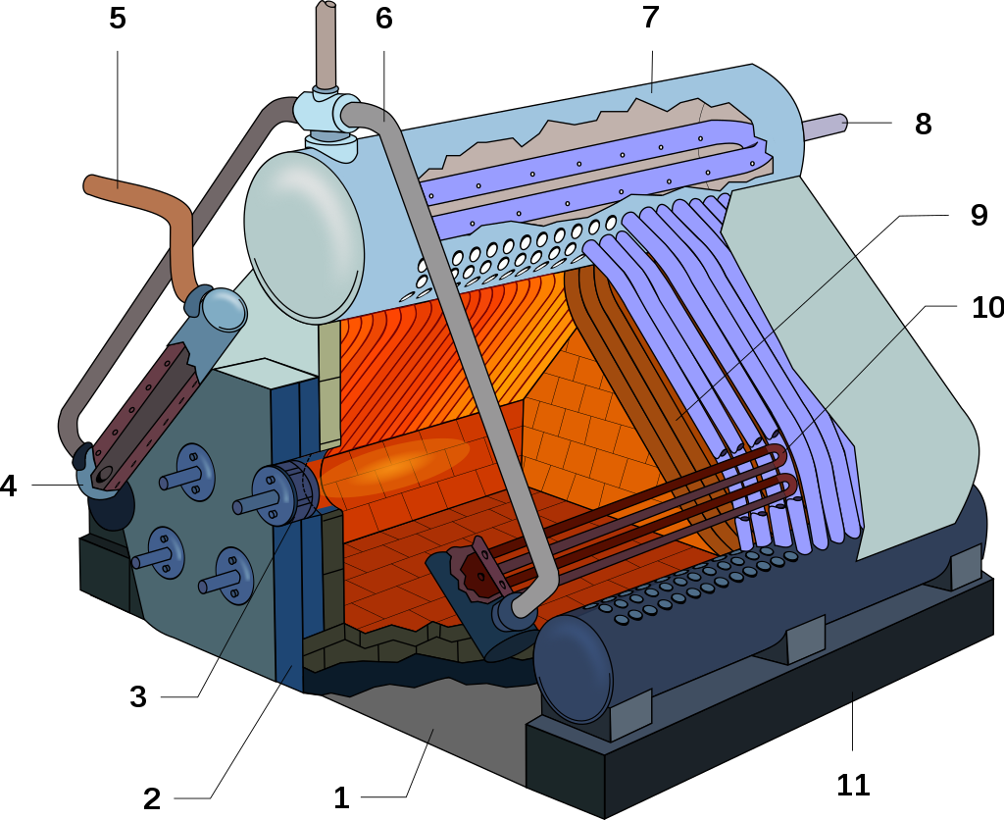
High-pressure oil-fired boiler
Admiralty three-drum Boiler

Slide 27
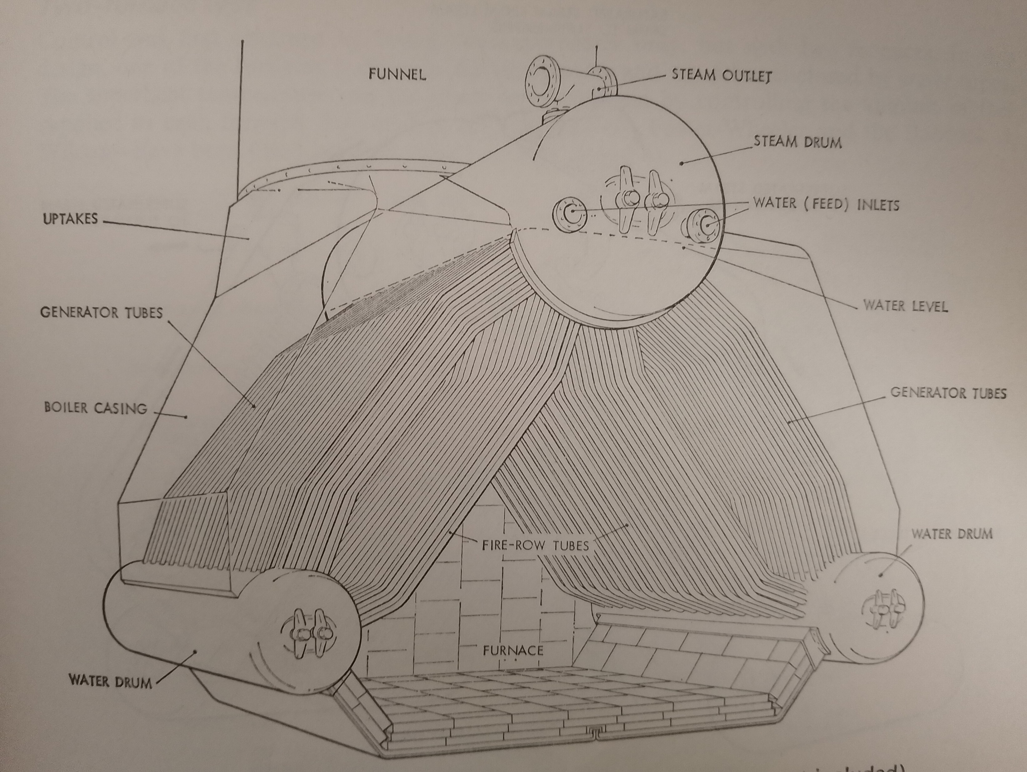
Admiralty three-drum Boiler

Slide 28
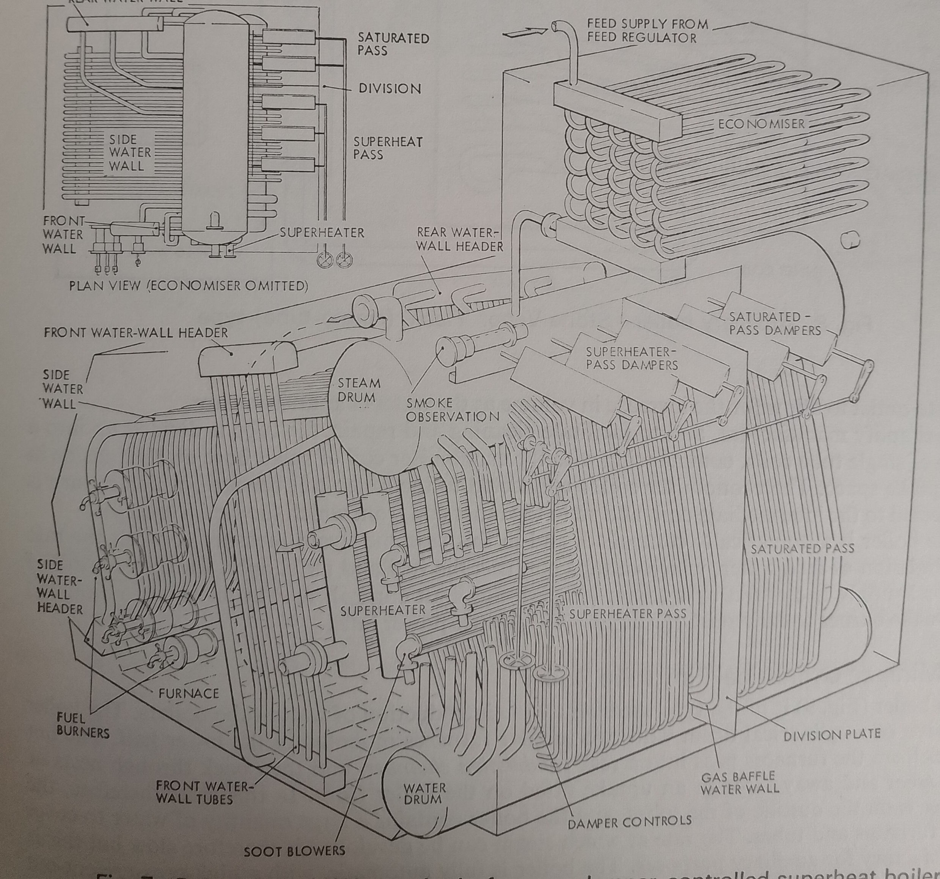


Babcock & wilcox three-drum Boiler

Slide 29
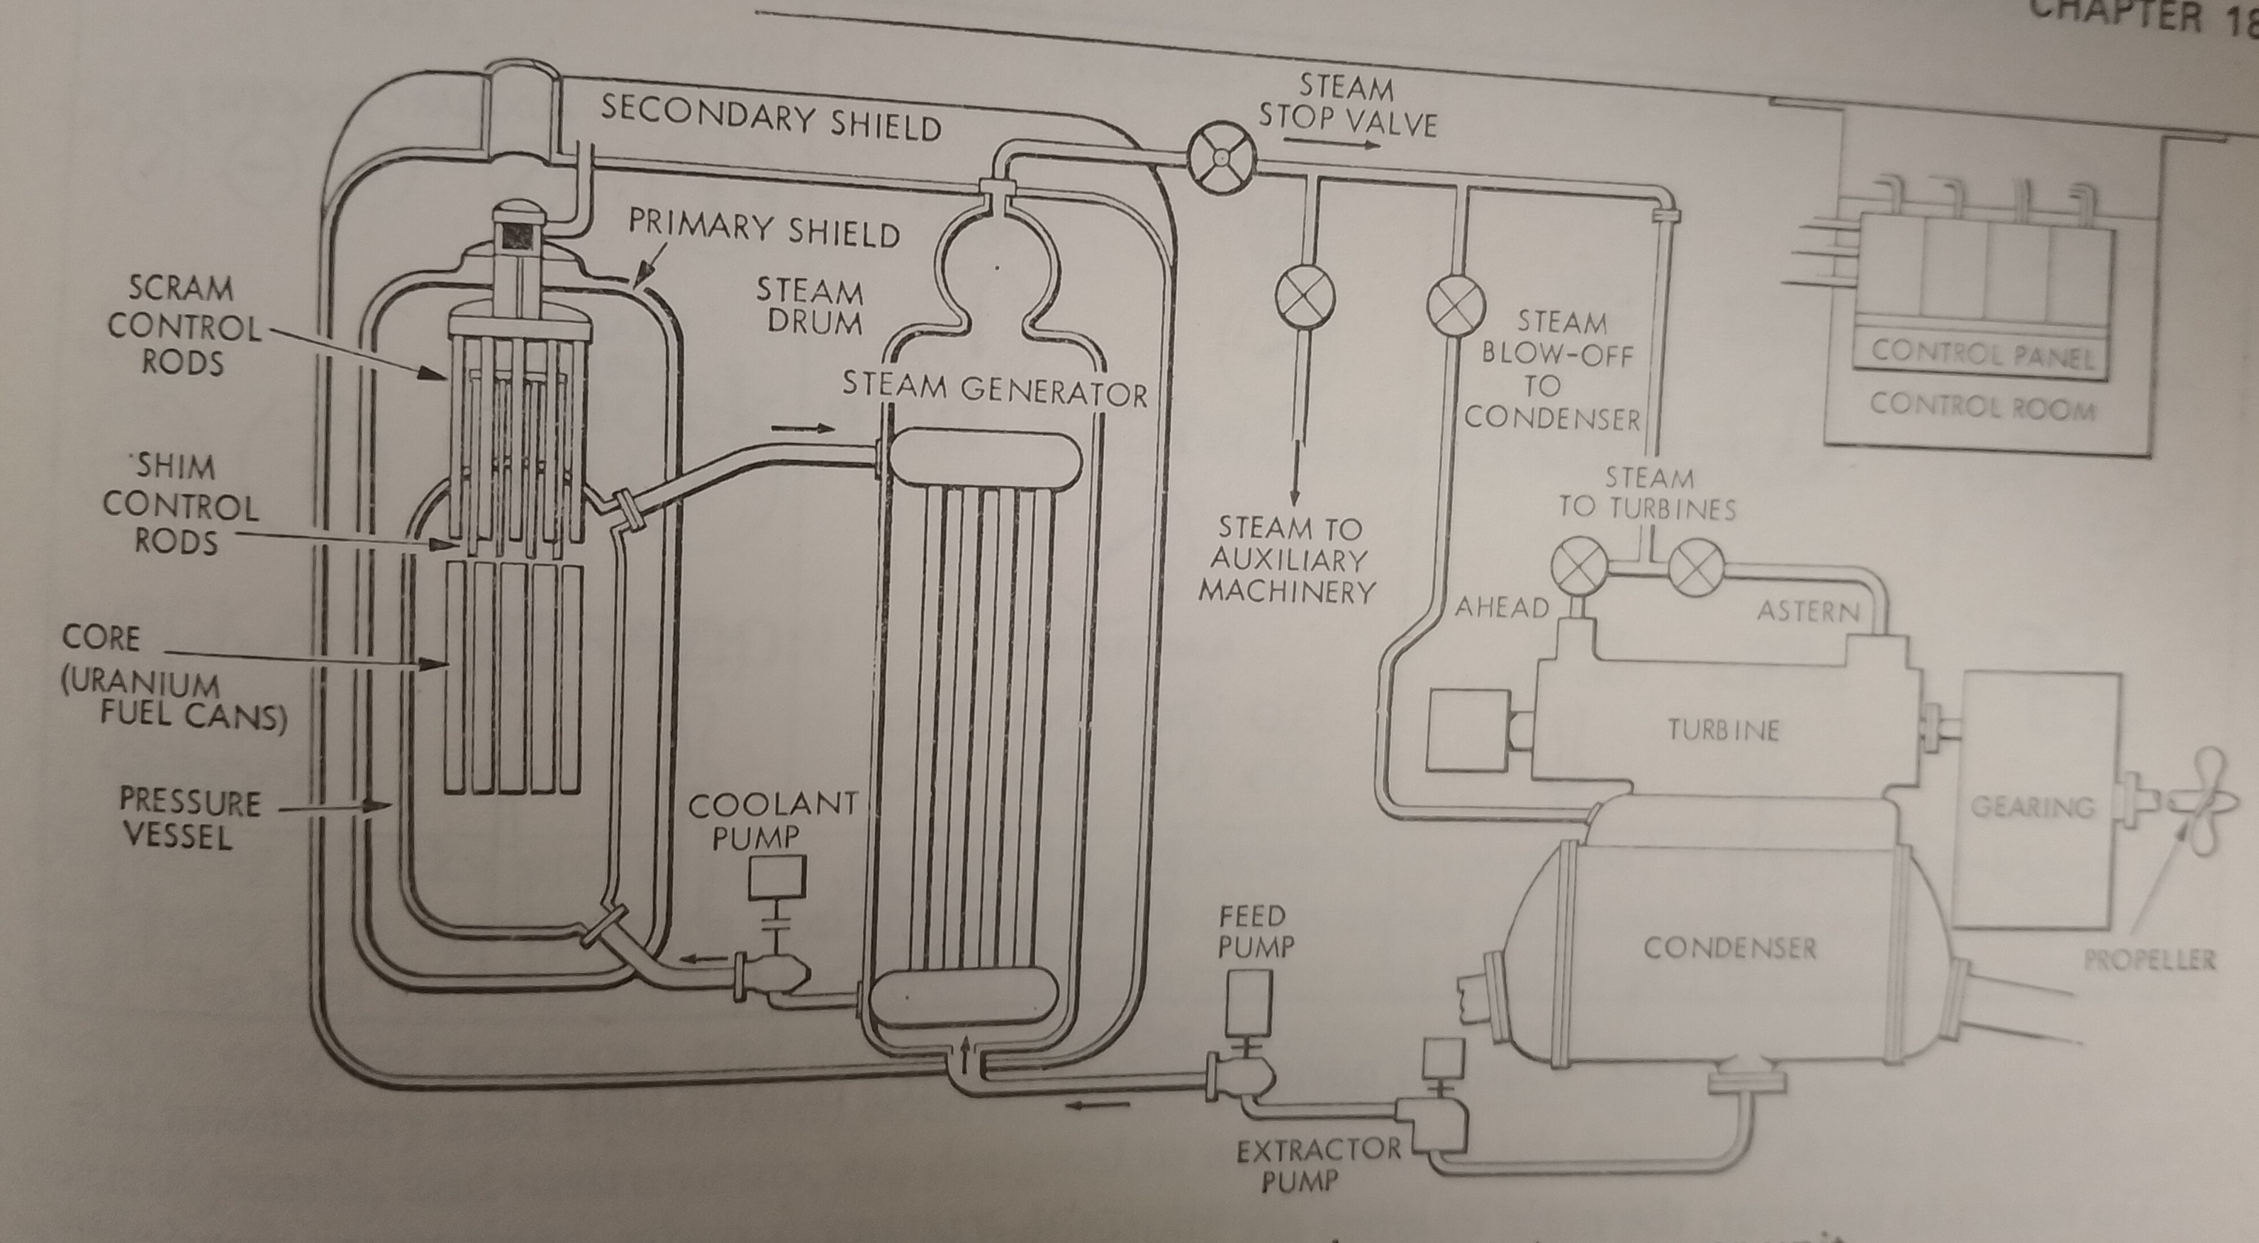
PWR Reactor power unit

Slide 30
Diving boilers

Slide 31
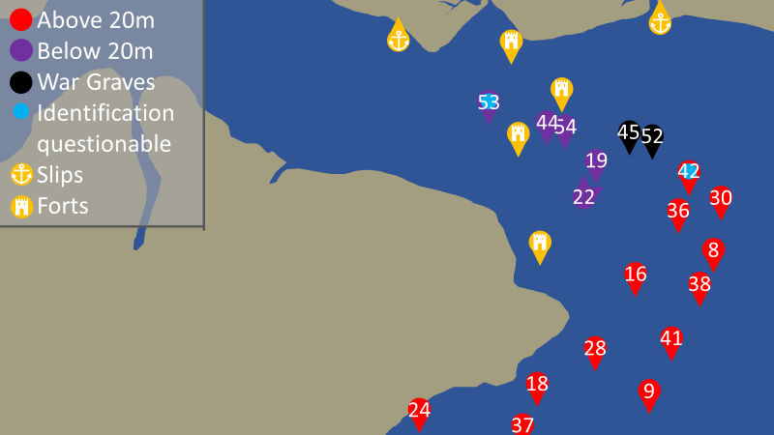
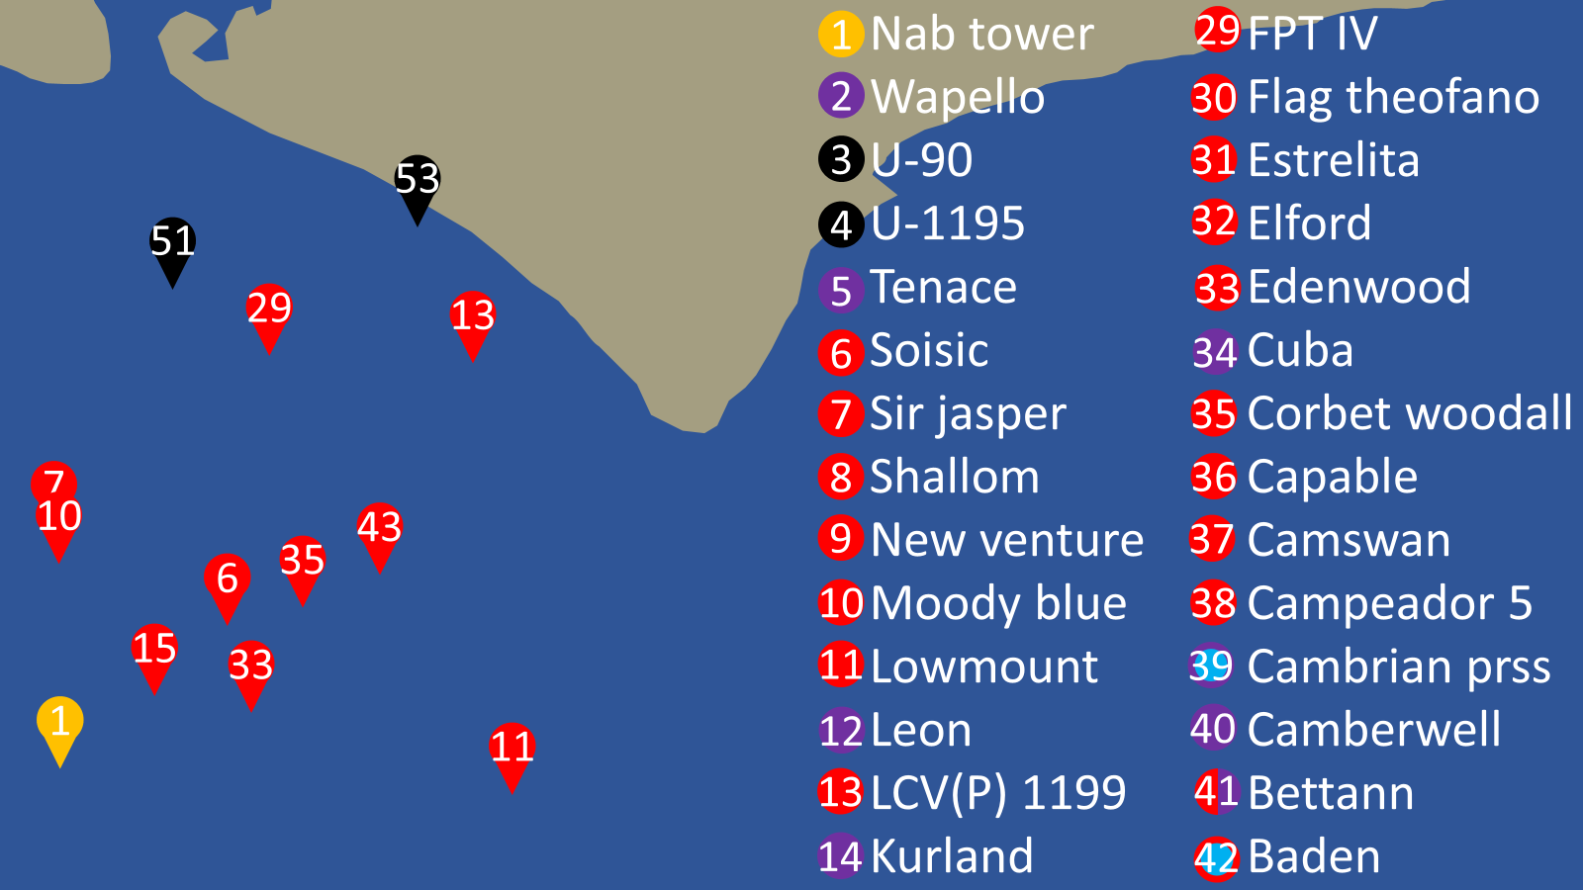
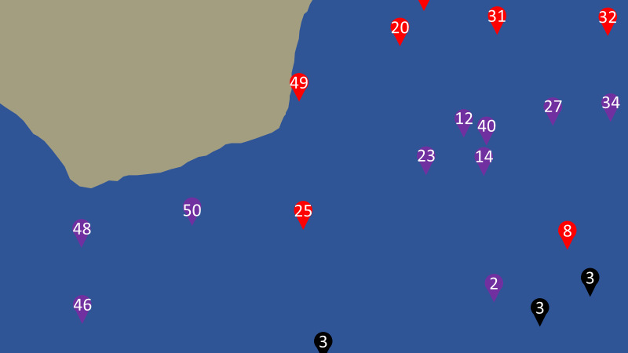
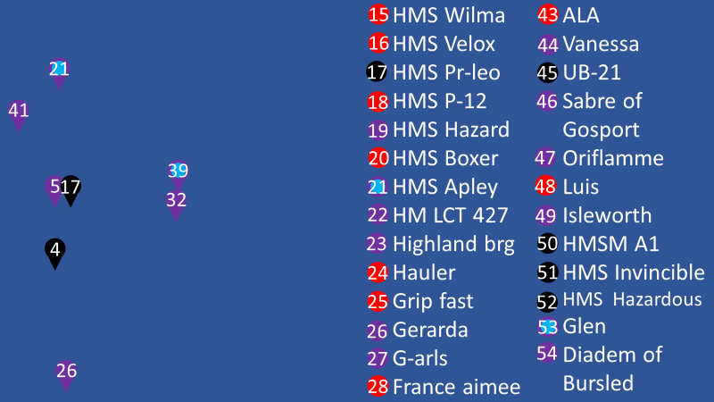

Slide 32
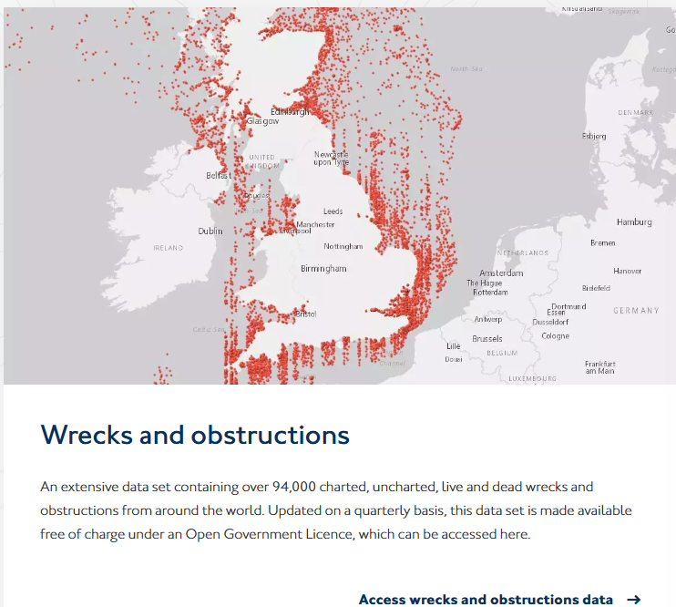
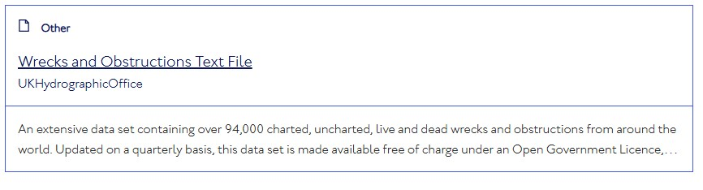
https://www.admiralty.co.uk/access-data/marine-data

Slide 33
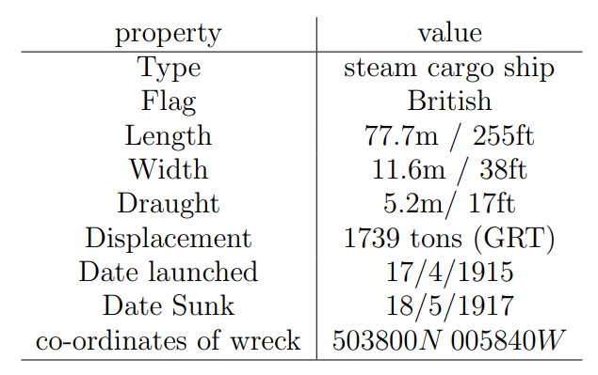

Slide 34

https://hec.lrfoundation.org.uk/#

Slide 35
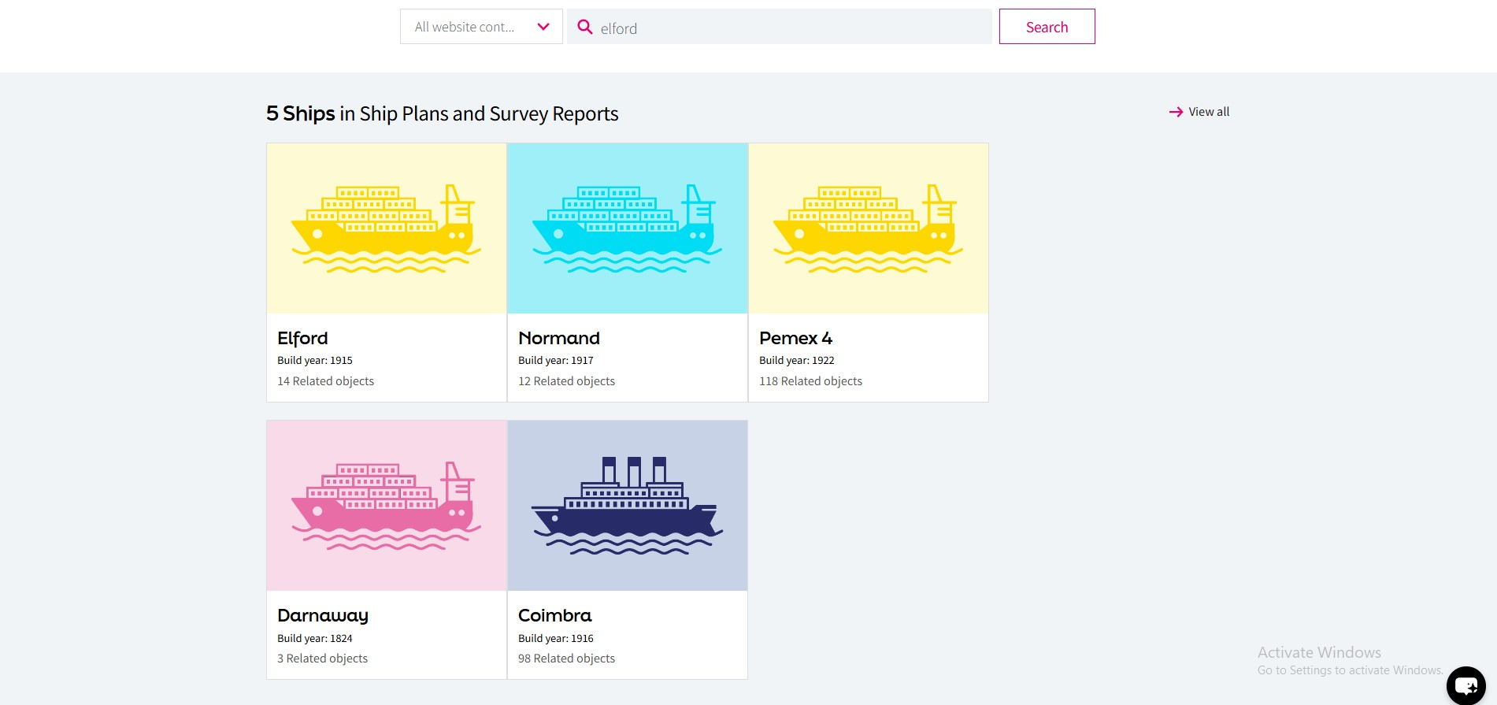

Slide 36
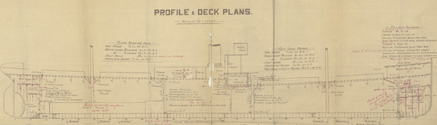

Slide 37
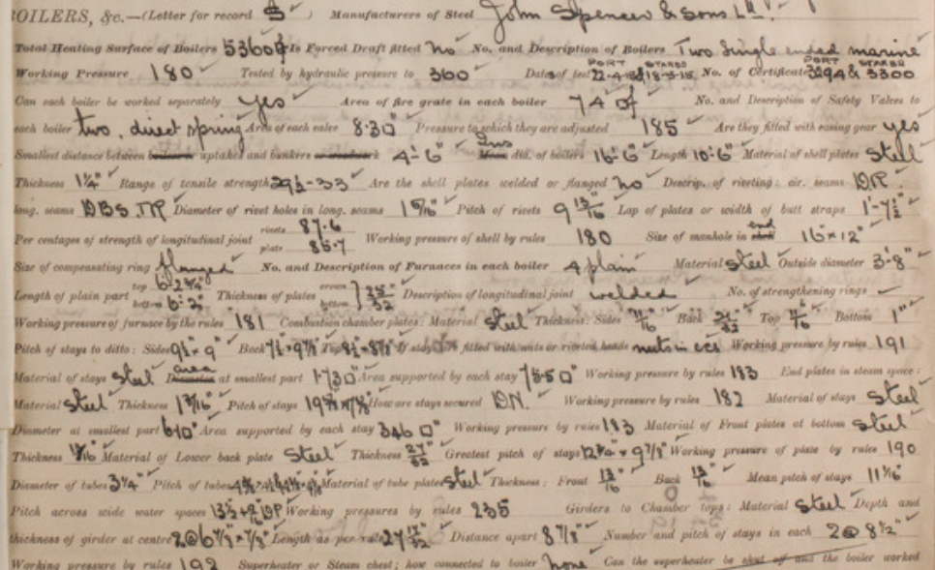

Slide 38
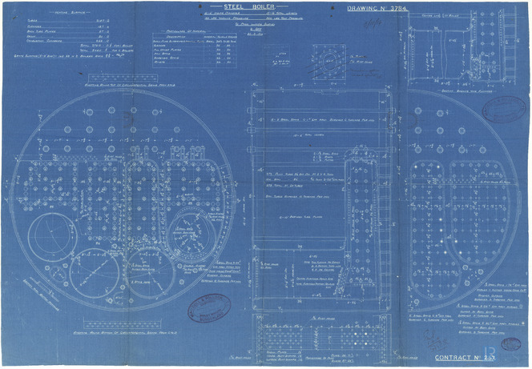

Slide 40
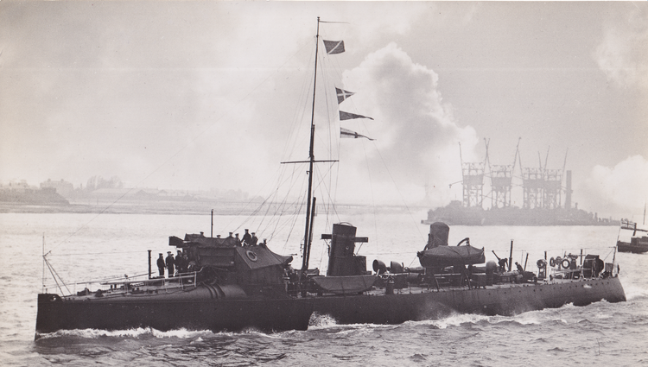
HMS Boxer

Slide 41
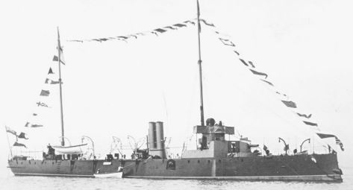
HMS Spider (1887)

Slide 42
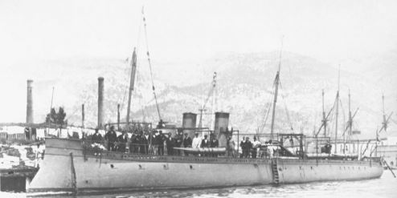
MN Ouragen

Slide 43
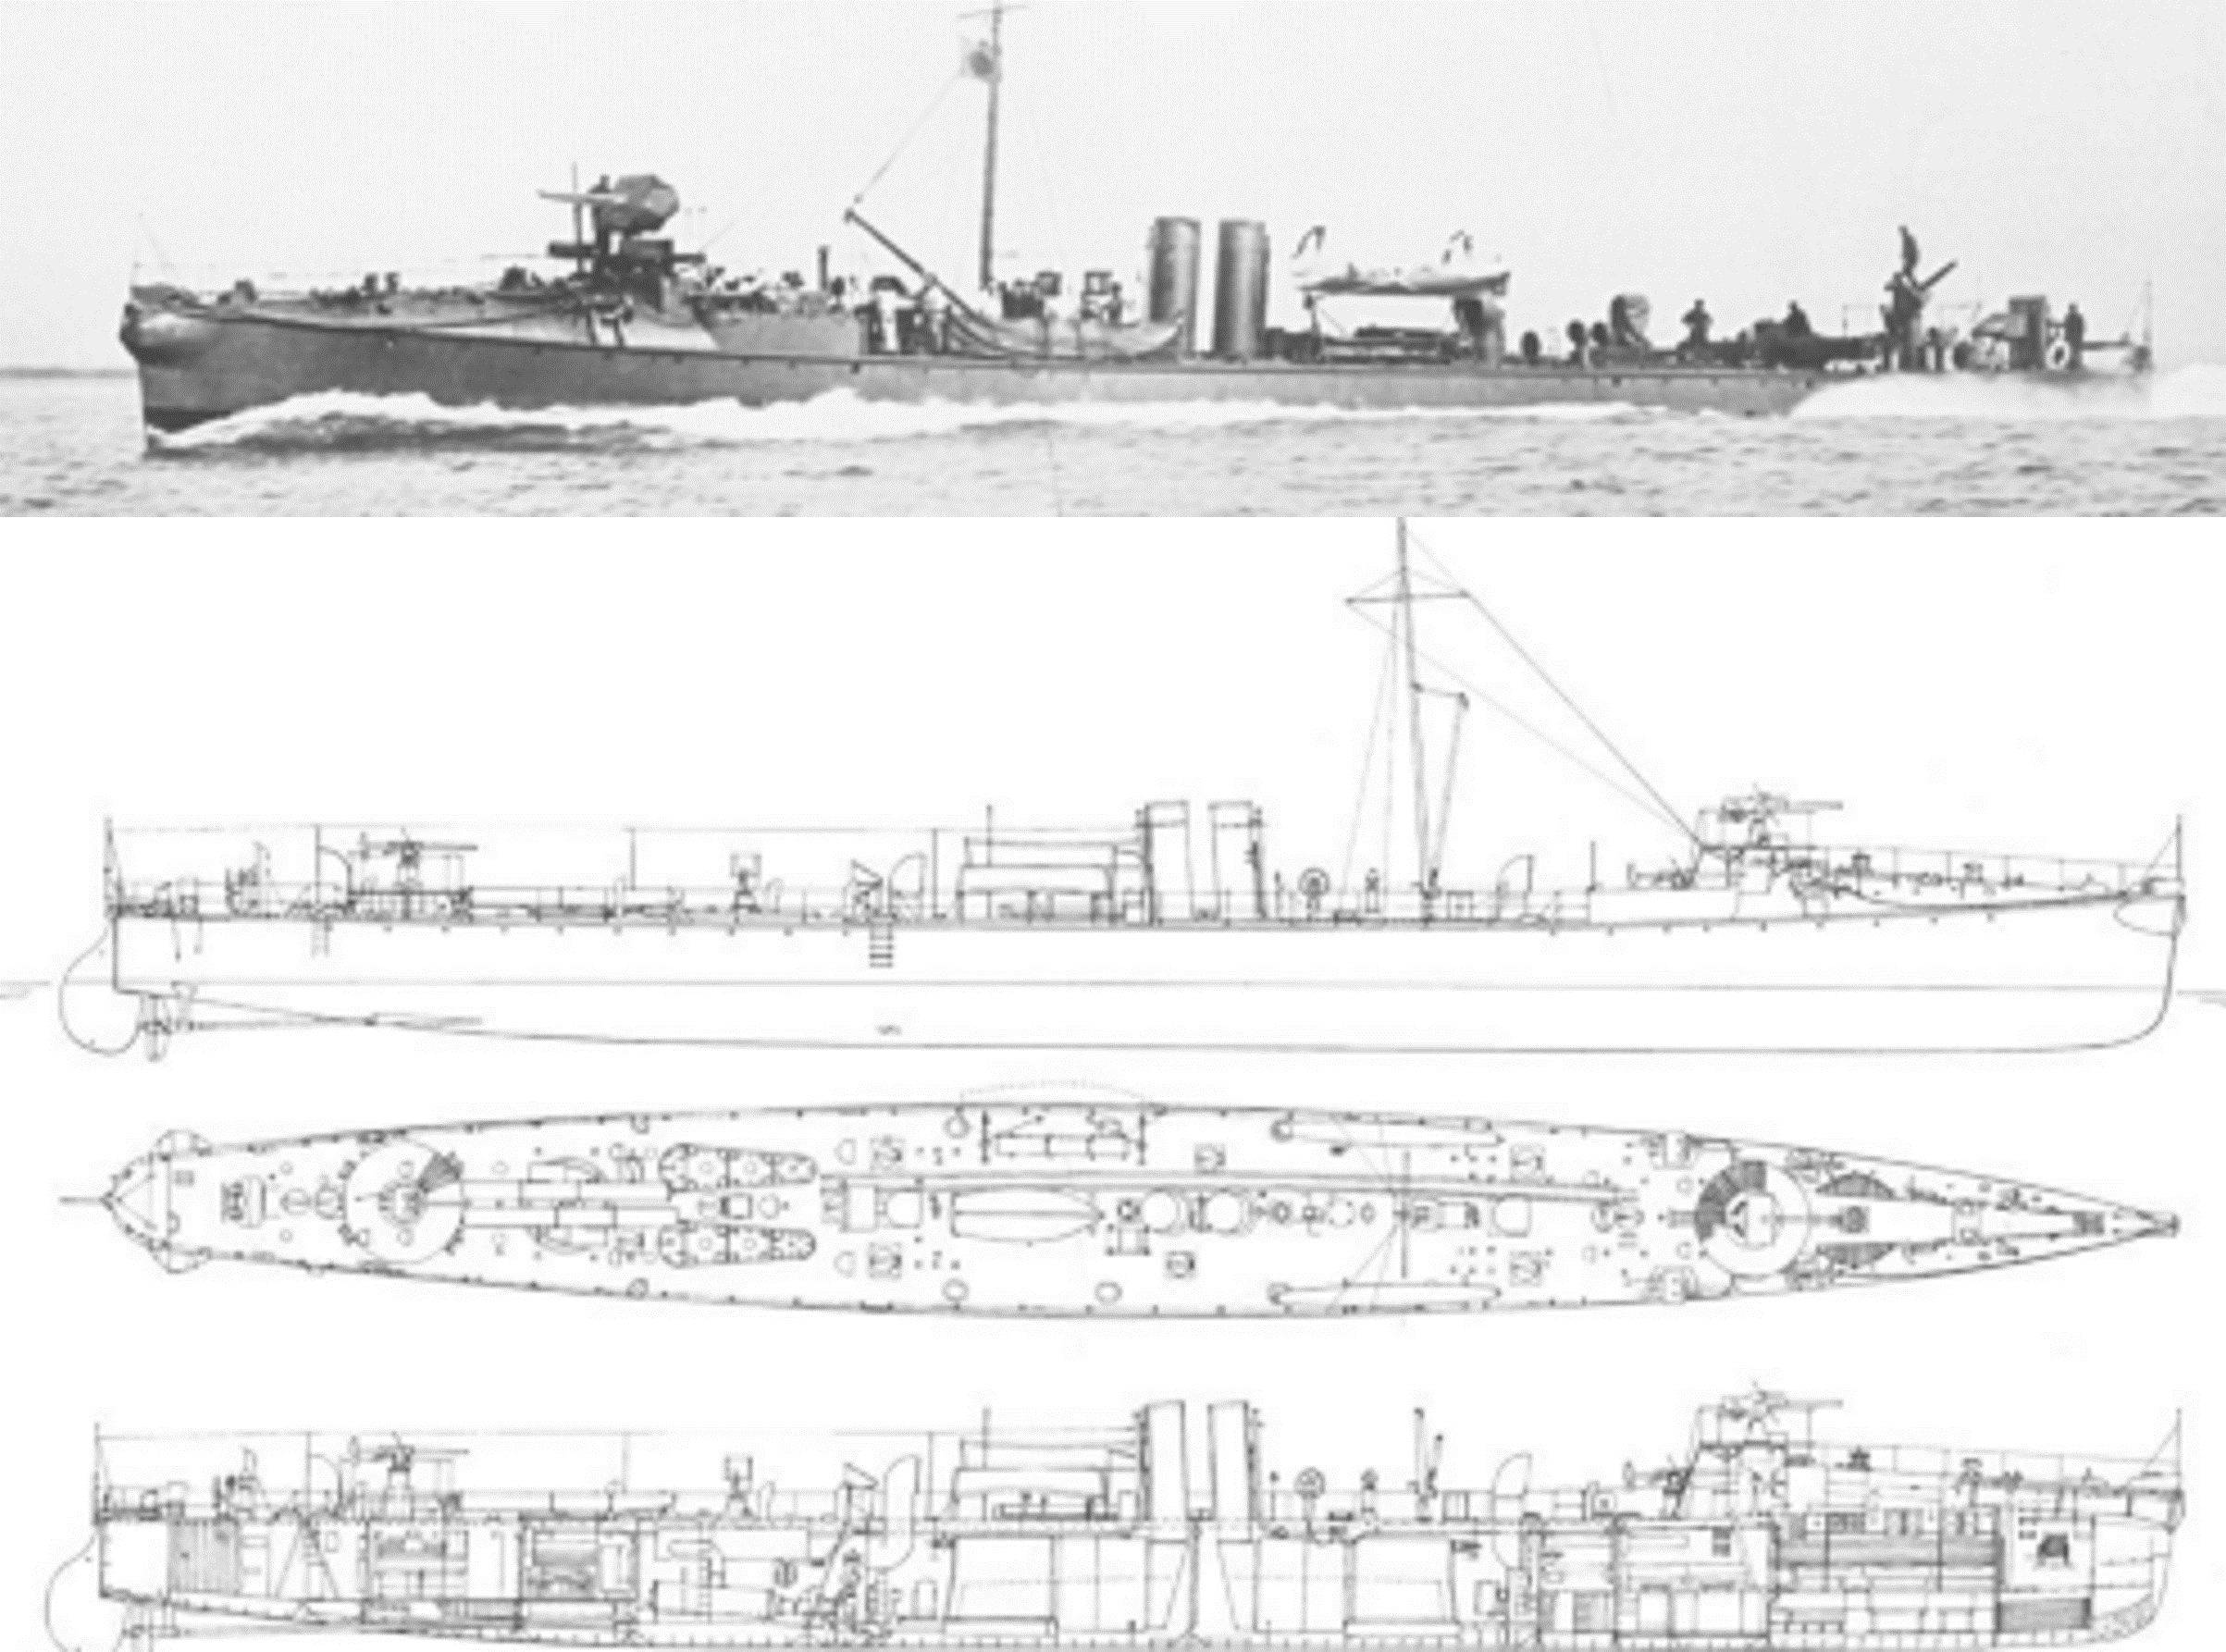
HMS Havock

Slide 44
HMS Boxer

Slide 45
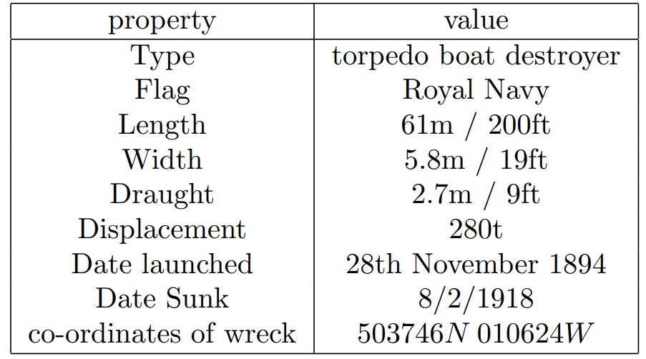

Slide 46
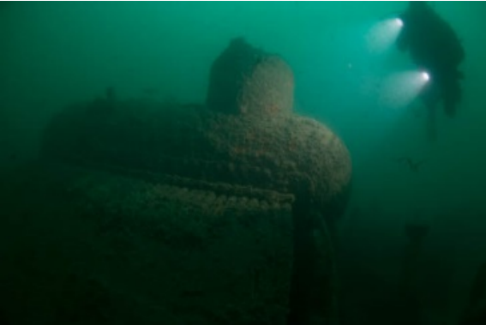
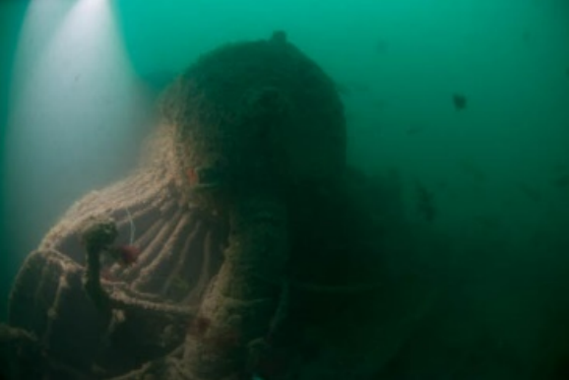

Slide 47


Slide 49




Slide 50


Slide 51


Slide 52

HMS Maori

Slide 53


Slide 54




Slide 55


Slide 56

HMS Mashona

Slide 57

KMS Bismarck (1940)

Slide 58
Maritime Boilers Lecture

